Slide 1
slsh:~$ Simple Linux Shell
Presented By
Istiaq Ahmed Fahad
Exam Roll: 60919
Supervised By
Dr. Kazi Muheymin-Us-Sakib
<number>

Slide 2
01
Project Overview
<number>

Slide 3
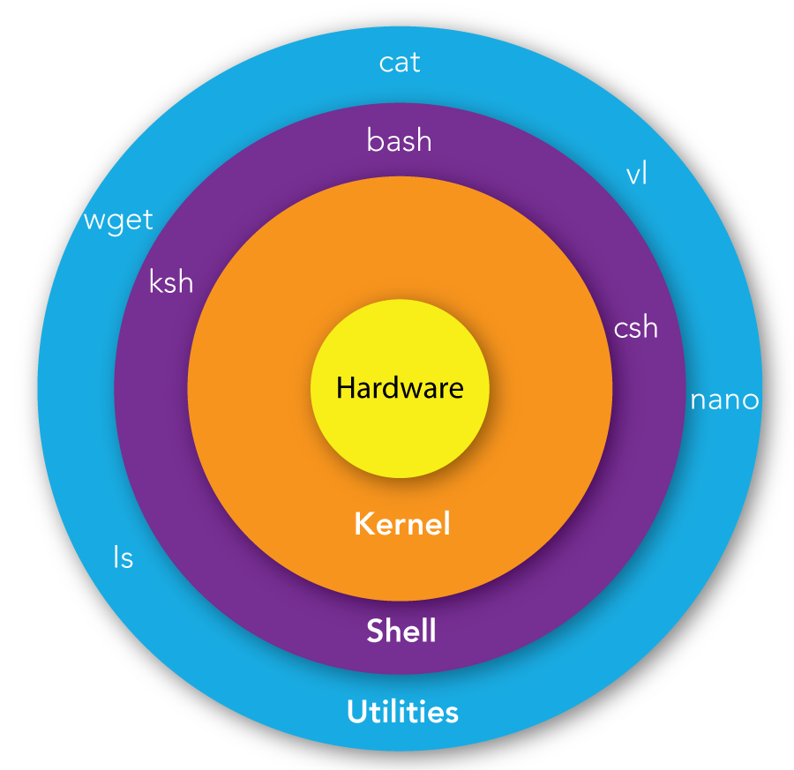
What is Shell
Shell is an interface present between the kernel and the user. It’s primarily used to access the services provided by the operating system.
<number>

Slide 4
I will recreate a simple Linux Shell (Bash) that includes the following features:
Executing Shell Command
Pipelined Command Execution
Input-Output Redirection
Command Name Customization (aliasing)
Tentative Command Suggestion
Terminal Color Customization
Shell History Management
<number>

Slide 5
02
How It Works
<number>

Slide 6
Basic Shell Operation
Breaks the input into words and operators and Parse the tokens into simple commands
Execute the parsed command through exec system calls.
1
2
3
4
5
Reading Input from user’s terminal
Performs shell expansions and any necessary redirections
Optionally waits for the command to complete and collects its exit status
<number>

Slide 7
Tentative Command Suggestion
In case of entering wrong commands, we’ll suggest the closest available commands. We’ll use the BK-Tree data structure to store the closest commands that are based upon Levenshtein Distance (Edit Distance) and will perform Inorder traversal of that tree to find the closest command as a suggestion. In addition, we’ll also implement KMP String Matching Algorithm to find the matched substring of given commands in order to find the executable file.
Pipelined Command Execution
Pipeline is a collection of one or more set of commands partitioned by the pipe '|' control operator. The output of each command in the pipeline is linked to the following command's input through a pipe. Also we have used File Descriptors to connect the stdin to another stdout of commands.
Input-Output Redirection
Redirection allows us to exchange the standard input (stdin) and standard output (stdout) with given input/output file. This redirection are denoted by redirection operator (>, <) in between commands and the file name. By replicating the file descriptors, we have redirect the stdin and stdout to the files mentioned in the shell command.
<number>

Slide 8
Shell History Management
Our shell keeps track of user command history. Users can invoke specific commands using the history expansion character (!). It keeps track of user command history through maintaining a specific serial number. Using this serial we can invoke particular command through history expansion character.
Customizing Text & Background Color
Our shell will also enable the user customize the text color as well as the background color using the ANSI Escape Codes.
Command Name Customization (aliasing)
Users can assign short names or refactor shell commands through aliasing. The actual and aliased command are separated by equal sign (=) and mapped in a file for further execution. While executing the aliased command we replace the actual command with aliased one.
<number>

Slide 9
03
Tools & Technologies
<number>

Slide 10


Coding Language
C++
Operating System
Linux (Ubuntu)
<number>

Slide 11
04
Challenges
<number>

Slide 12
Challenges I have faced while doing the project is given as follows:
Learning about system process, parent and child process, process id and their interaction with Linux.
Learning character pointer and application of dynamic programming (malloc(), calloc())
Implementation of BK-Tree Data Structure, Levenshtein Distance, KMP String matching Algorithm, Parsing
Different shell features.
Managing large codebase and handling multiple C file.
<number>

Slide 13
THANK YOU
Github: https://github.com/ahmedfahad04/SPL-1
<number>

